Slide 2

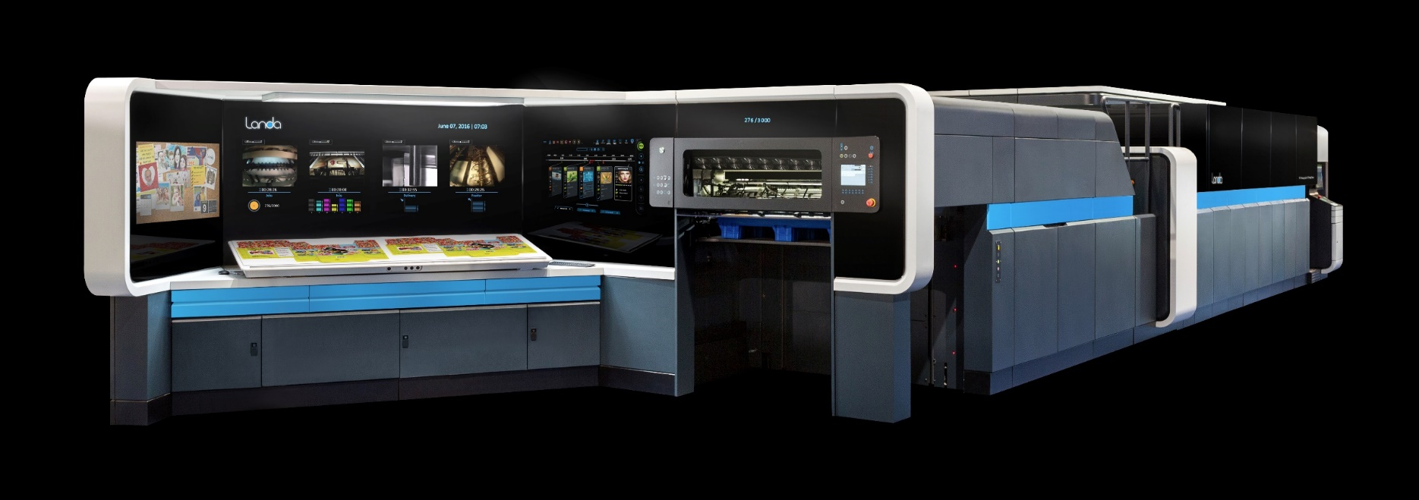
Landa Sales Training
August 2020

Slide 3
Agenda
Introduction to your new Landa S10 Nanographic Press
Introduction to Nanography®
S10 and Nanography’s Benefits over other technologies
How to sell Nanography!!

Slide 4
Agenda
Introduction to your new Landa S10 Nanographic Press
Introduction to Nanography®
S10 and Nanography’s Benefits over other technologies
How to sell Nanography!!

Slide 5
The Duggal Landa S10 Nanographic Printing® Press

Slide 6

What is Unique to your new Press?
First press delivered and installed in the world that is HD Ready
What does this mean?
  Currently the S10 prints with an effective resolution of 1700 DPI
  In HD mode, the effective resolution will be up to 2400 DPI

Slide 7
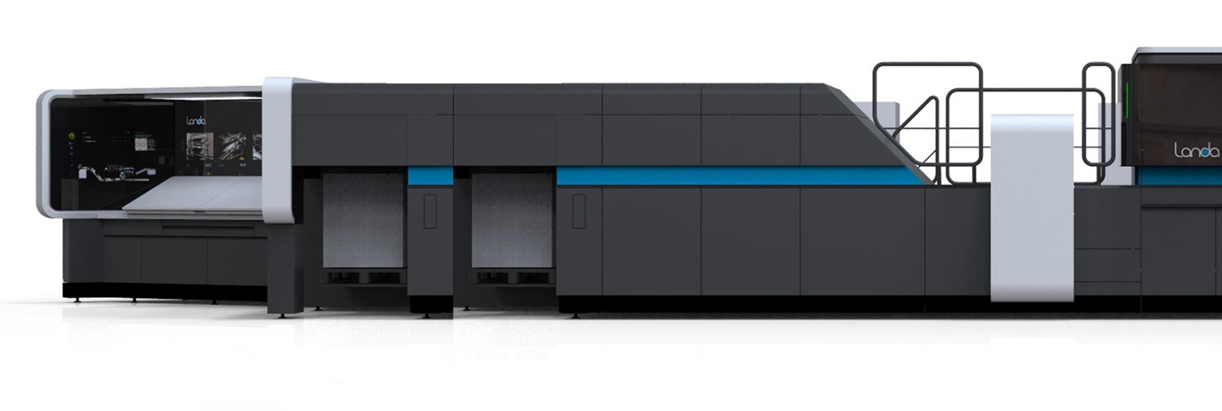
What is Unique to your new Press?
First Double Delivery S10 Press in the world

Slide 8
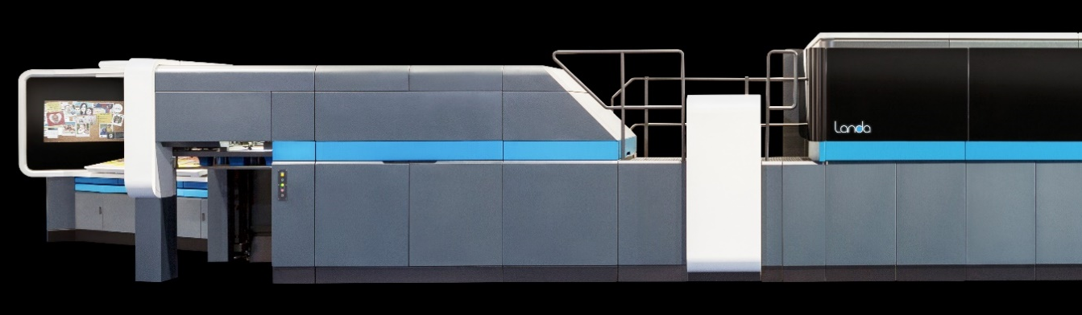
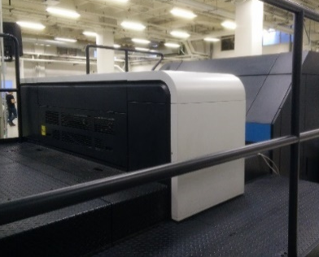
Landa S10 Inline Coating Unit
Industry-standard coating unit
Supports UV/aqueous coatings
Uses Standard coatings
No need to re-approve coating
types with print purchasers
  Inline Coating Unit
February 2020

Slide 9
What is Unique to your new Press?
Newest Print head Technology
  Prints with drop size of only 3 picoliters and can also print 6 and 9 picoliter drops if needed.
What is a picoliter? ( 1 trillionth of a liter)
How small is 1 trillionth ( 1/1,000,000,000,000)

Slide 10
3 trillionths of a liter is equivalent to

Slide 11
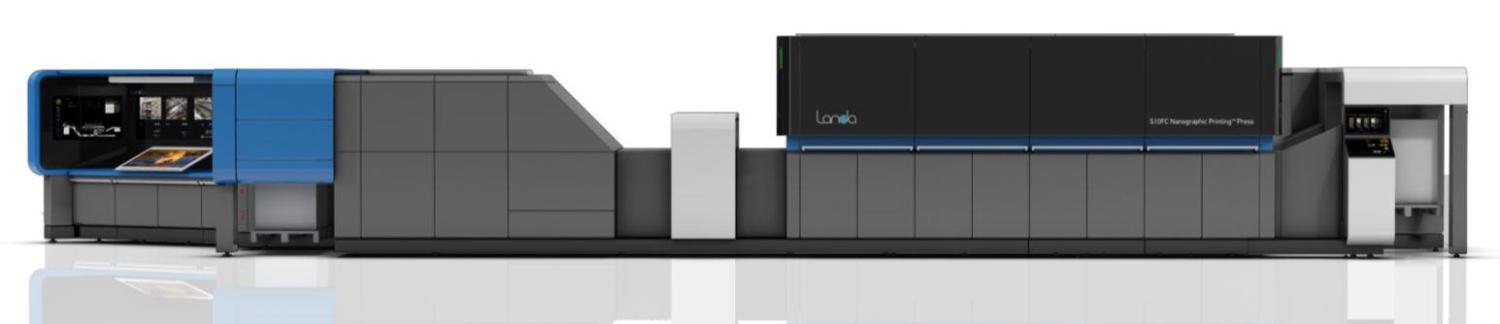
Landa S10 Nanographic Printing® Press
  Sheetfed press, simplex
  fully automated paper handling by Komori
B1
Max sheet size - 750x1050 (29.5 x 41.3 in.)
Max printing area - 730x1032 (28.7 x 40.6 in.)
Offset quality printing
30% wider gamut than ISO offset
FM screening
Printing speed: 6,500 SPH
@7 color printing
Supports all types of carton board: virgin & recycled, 2 side & one side coated, and metalized boards
CMYK
OGB
    Landa User Interface: The innovative Landa ‘cockpit’ and service tools
Media thickness: 40 to 800 microns (1.6-32 pt)
1700 effective DPI ( up to 2400 DPI in HD)
MEMS design, Piezo Drop On Demand
Closed-loop quality and inspection systems
Notes:
Light Paper support TBD

Slide 12
Agenda
Introduction to your new Landa S10 Nanographic Press
Introduction to Nanography®
S10 and Nanography’s Benefits over other technologies
How to sell Nanography!!

Slide 13
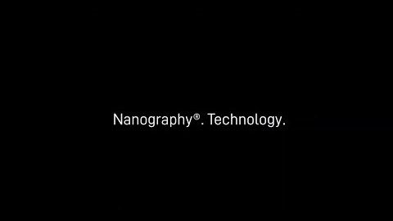
Nanography Dr. Nano explains !!

Slide 14
Nanography®
Main Take-Aways

Slide 15


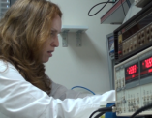
Landa NanoInk®
Years of research at Landa Labs led to the development of Landa NanoInk®
Nanotechnology
Nanopigments
Landa NanoInk®
February 2020

Slide 16
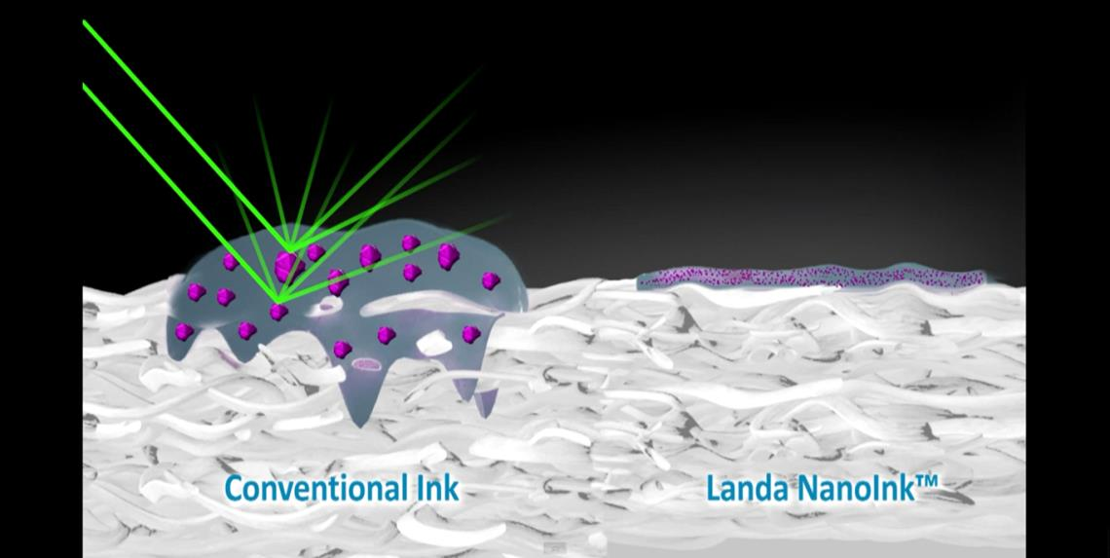
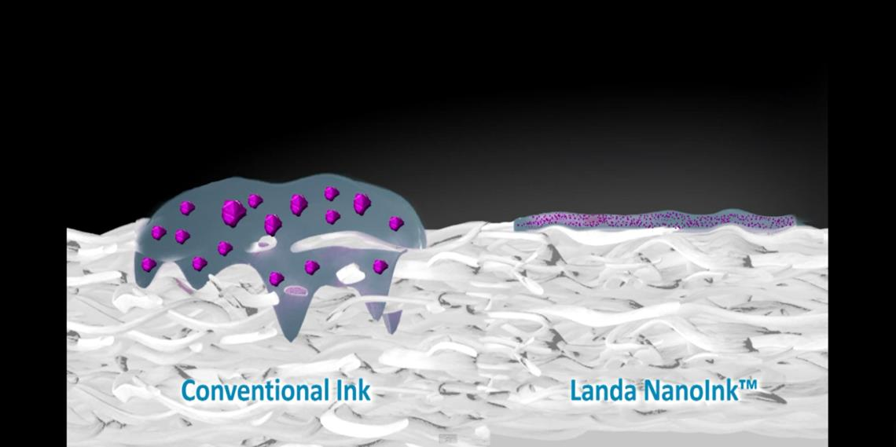
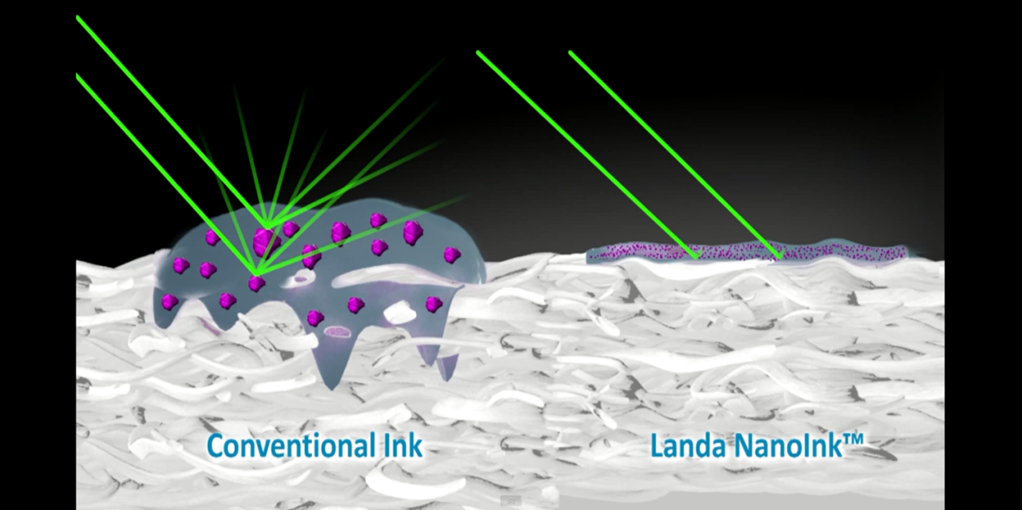
NanoInk®: Optical Characteristics
Nano-pigments are extremely powerful absorbers of light, enabling zero scatter
February 2020

Slide 17
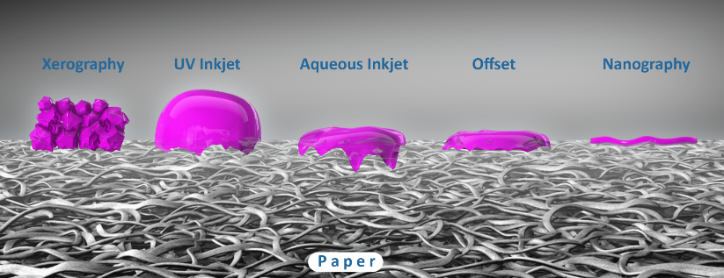
NanoInk®: Ultra-Thin Images
NanoInk characterized by ultra-thin dots of extremely high uniformity
  5 microns
  0.5 microns
February 2020

Slide 18
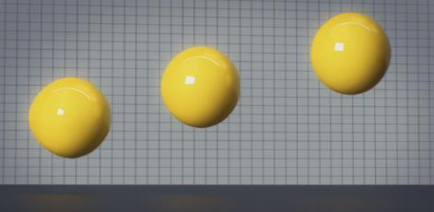
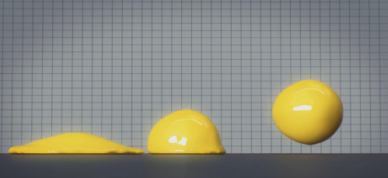
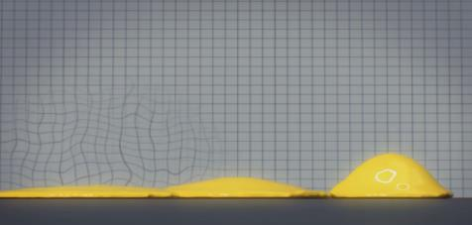

The Nanographic Printing® Process
Eject billions of Landa NanoInk® droplets onto the blanket
Dry ink to form an image
Transfer image to the substrate
50-70 um
500 nm
February 2020

Slide 19
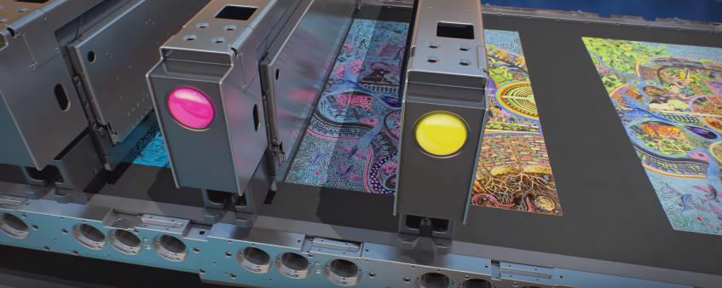
The Nanographic Printing® Process
Eject billions of Landa NanoInk® droplets onto the blanket
Dry ink to form an image
Transfer image to the substrate
February 2020

Slide 20
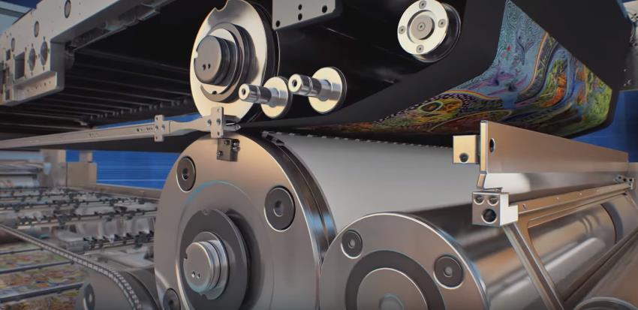
The Nanographic Printing® Process
Eject billions of Landa NanoInk® droplets onto the blanket
Dry ink to form an image
Transfer image to the substrate
February 2020

Slide 21

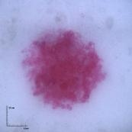
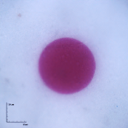
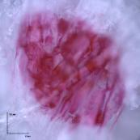
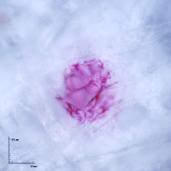
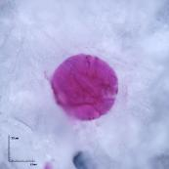
Dot Sharpness and Uniformity
Offset
HP Indigo
Inkjet
Coated Paper
Uncoated Paper
February 2020

Slide 22
Agenda
Introduction to your new Landa S10 Nanographic Press
Introduction to Nanography®
S10 and Nanography’s Benefits over other technologies
How to sell Nanography!!

Slide 23
Benefits of the Landa S10 and Nanography over other Technologies

Slide 24
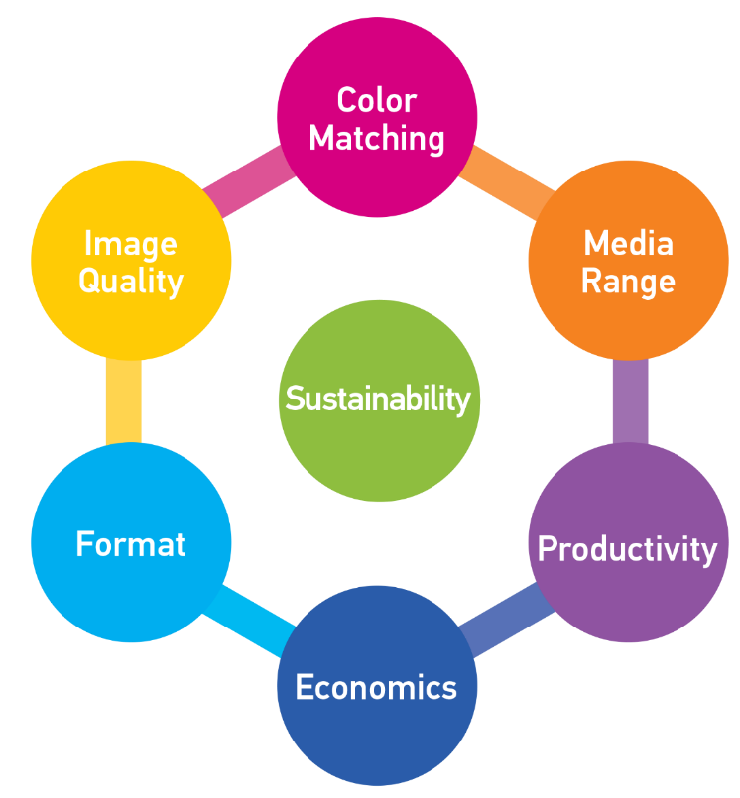
Digital Printing for Mainstream Production
To replace conventional print technologies…
…digital printing needs to at least match their print capabilities
February 2020

Slide 25
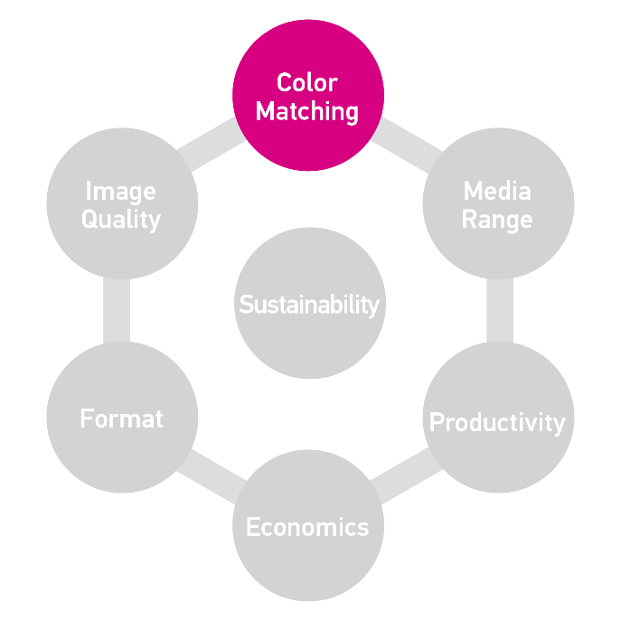
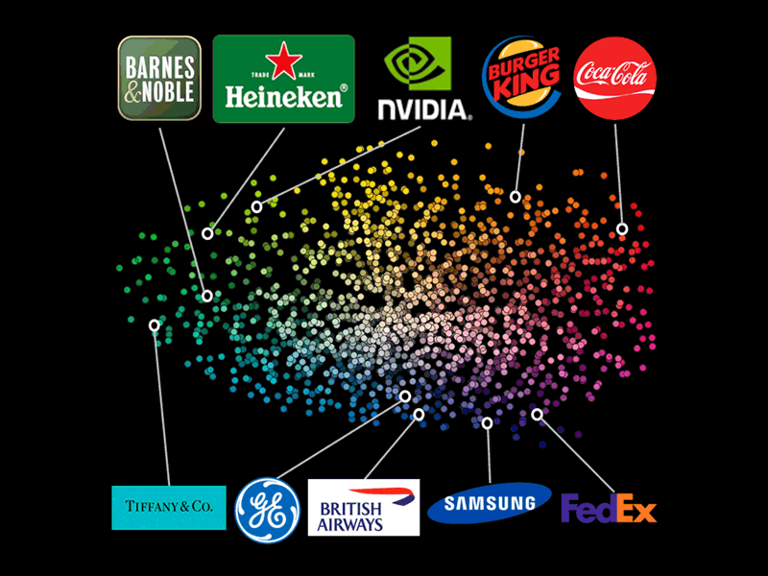
The Widest Color Gamut
February 2020

Slide 26
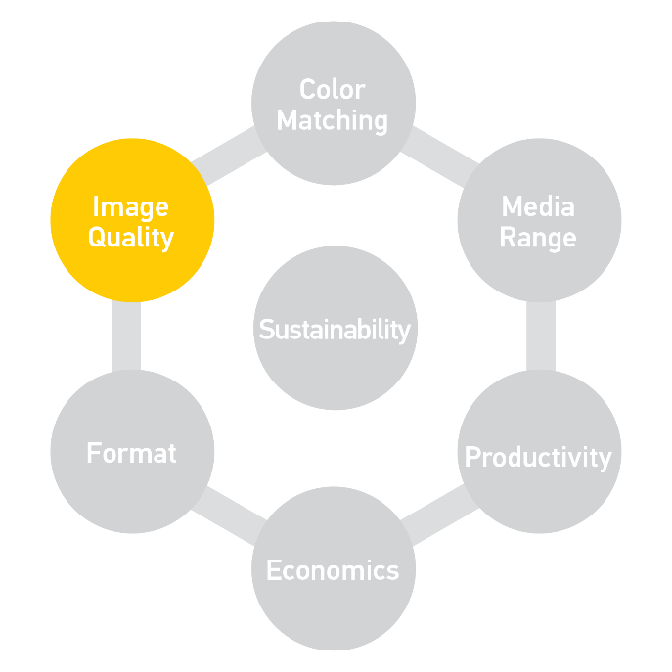
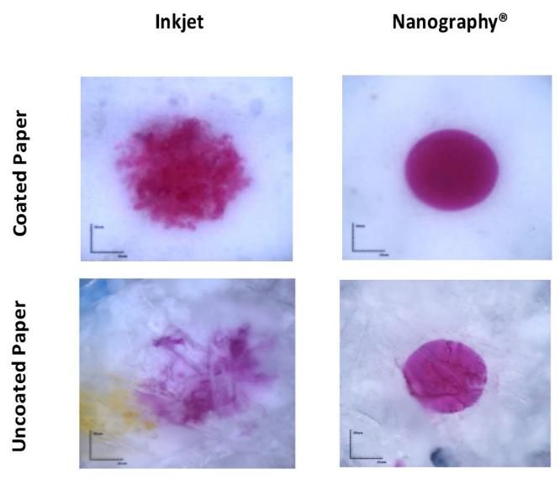
The Sharpest Images
Inkjet Nanography
February 2020

Slide 27
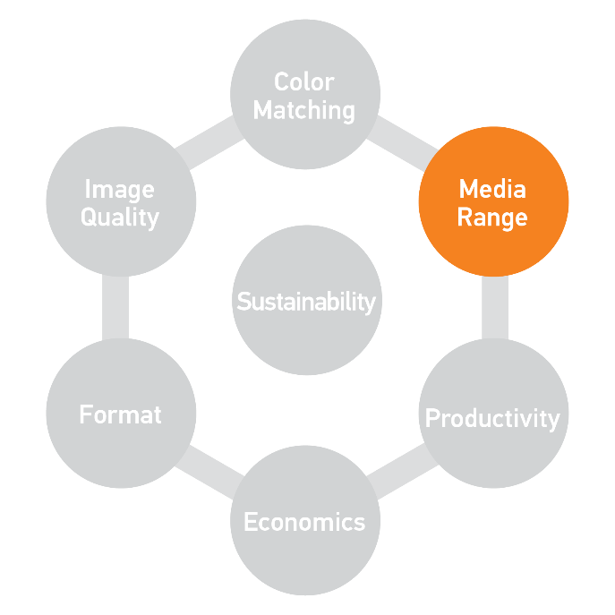
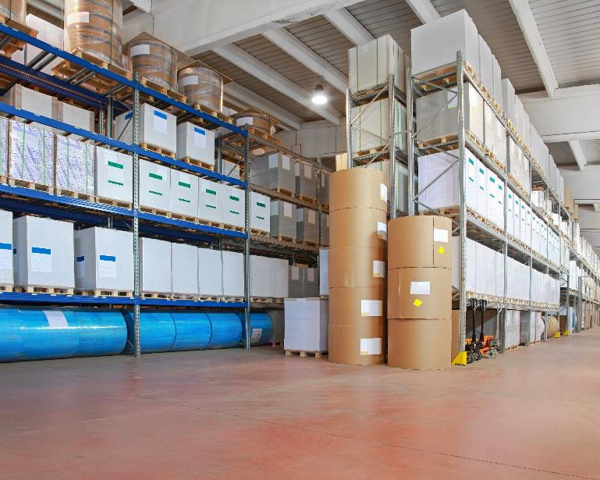
Any Paper… Without Treatment
February 2020

Slide 28
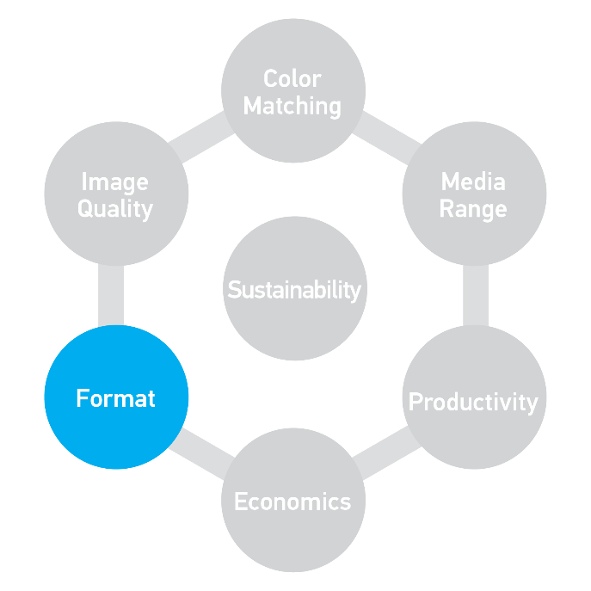
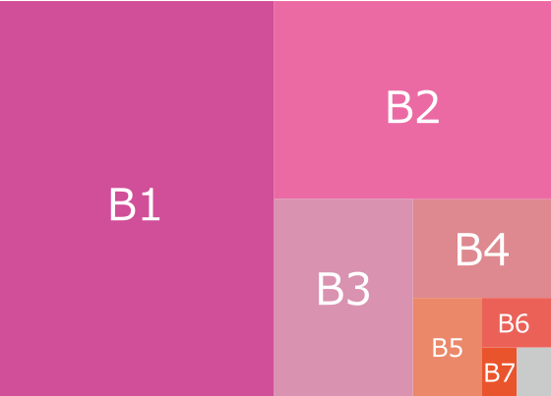
The Right Format
Print industry’s most common format
February 2020

Slide 29
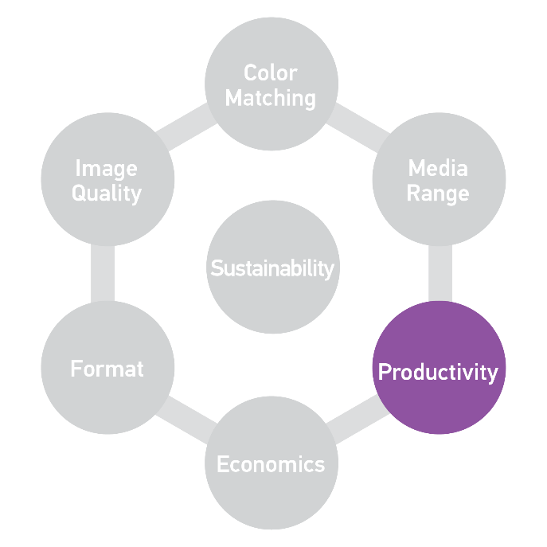
Production Speeds
Sheet-fed Digital Presses
February 2020

Slide 30
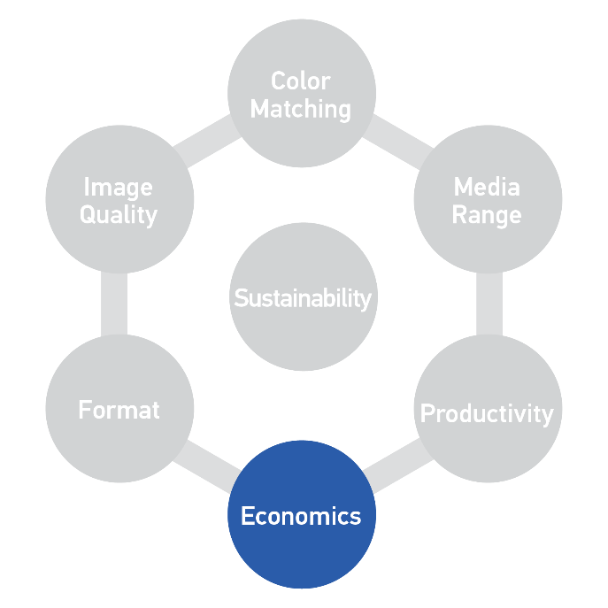
Profitable at Short-Mid Runs
Productivity
(Speed x Format)
+
Efficiency
(− Set-up Costs − Spot Colors)
+
Compatibility
(+ Fit: Paper + Finishing)
=
Profitability
February 2020

Slide 31
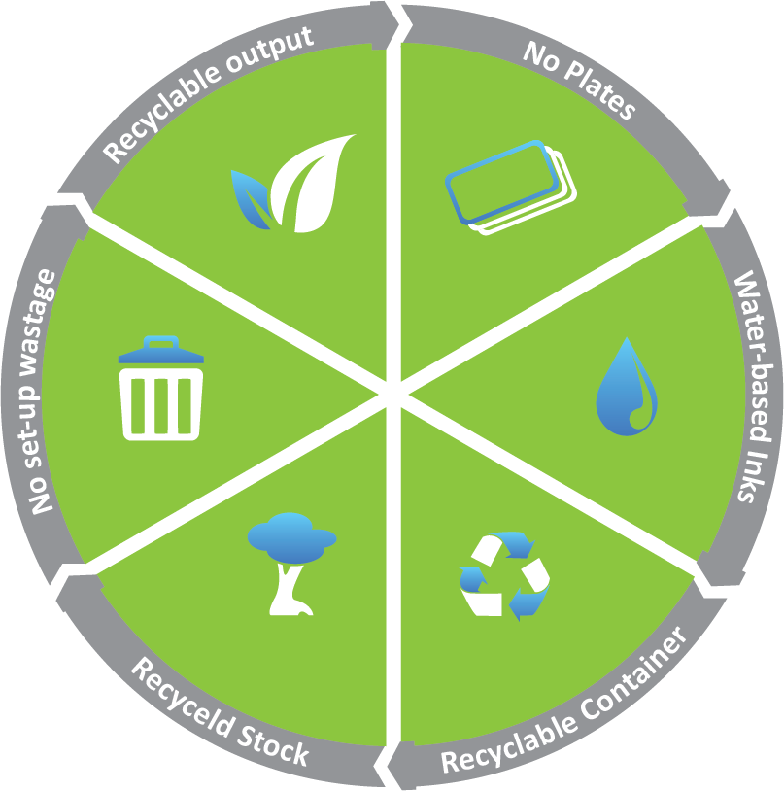
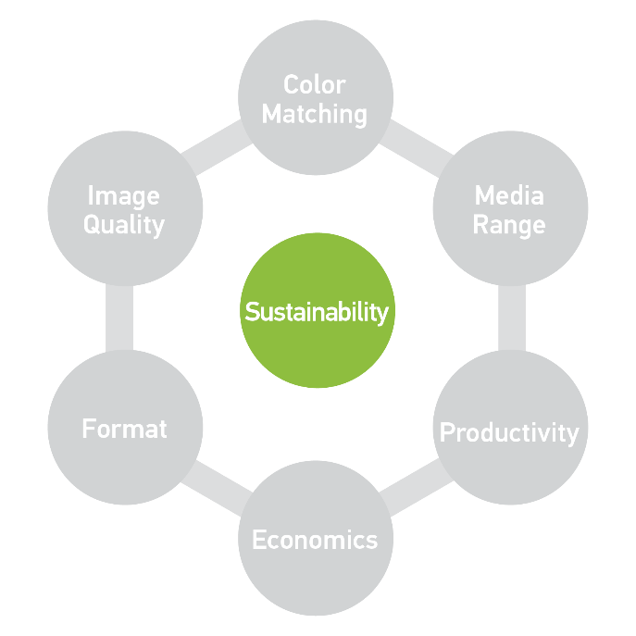
Sustainable Print Process
February 2020
Notes:
Mention that we print in HIGH QUALITY on recycled stocks
Attained relevant deinking and recycling certifications & proof-points
Co2 Assessment & Environmental Certifications

Slide 32
Printing. Without Compromise.
✓
✓
Color Matching
✓
Image Quality
Media Range
Everything you expect from a conventional press
Everything you need from a digital press
Everything you want from a Landa press
Sustainability
Format
Productivity
✓
Economics
✓
✓

Slide 33
Agenda
Introduction to your new Landa S10 Nanographic Press
Introduction to Nanography®
S10 and Nanography’s Benefits over other technologies
How to sell Nanography!!

Slide 34
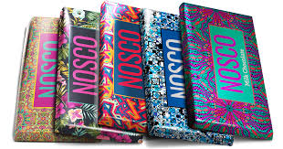
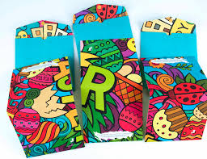
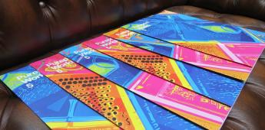
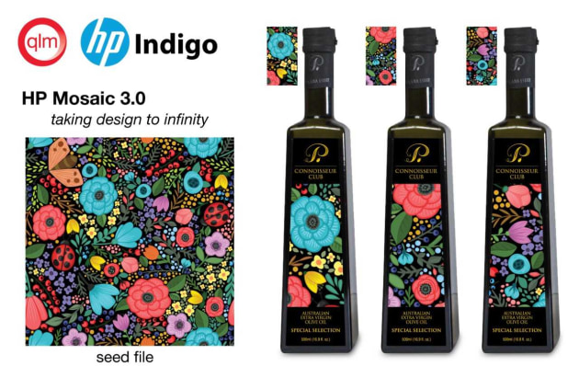
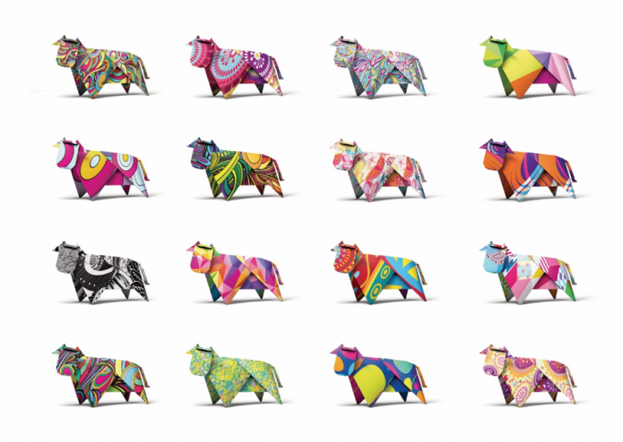
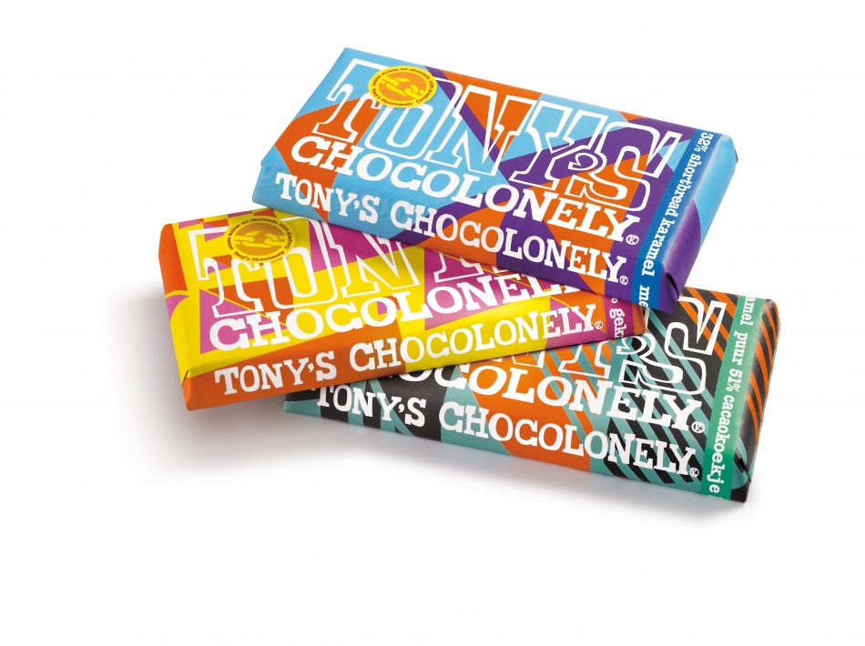
Innovative, Unique packages

Slide 35


The Benefits of Personalization
Enrich Products Portfolio
High Value Products – Premium prices
Innovation
Greater customer loyalty
February 2020

Slide 36
Short Runs
Identical results when reprinting
Minimizing exposure to your customer when launching new products
Reorders based on actual demand
SKU proliferation
End of life/long tail support
End to end TCO Model is key!
Print exactly what you need, when you need it!

Slide 37
Speed to Market & Flexibility
Shorter and more effective package/design development cycles
  Concept development – mockups that are identical to the final results
  Market research – focus groups, in-store
  Sales samples – sales staff, trade shows
Quick response to business cycles
Quick response to competition
Continuous improvement

Slide 38
Value Proposition
Delivering digital flexibility, profitable short to medium run length production, without compromise!

Slide 39
Without Compromise
Quality
Media Range
  Variety
  Format
Speed/productivity
Digital applications
Costs/pricing (Duggal internal)

